Slide 1
Results Presentation
Heyang Liu

Slide 2
Key Findings at a Glance
Unlike some previous literature suggesting an inverted-U pattern, we find a consistently negative relationship between Remittances/GDP and inequality.
Including macroeconomic variables significantly improves model fit, and shows the necessity of using education as control variables.
Basic education exhibits an inverted-U effect, while the nonlinear (U-shaped) impact of higher education becomes significant only after accounting for time fixed effects.

Slide 3
Methodology
We analyzed an unbalanced panel dataset of 558 observations from 72 countries between 1980 and 2015, using OLS and fixed-effects regressions to examine the relationship between income inequality and reliance on remittances (measured as remittances/GDP).
Control variables include education coverage and economic status of countries.
Time-fixed effects were incorporated using period-based groupings.

Slide 4
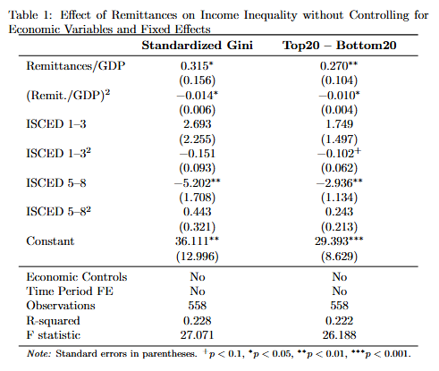
Simple model
Table 1 shows that remittances have a statistically significant inverted-U-shaped relationship with inequality. Higher education reduces inequality, while basic education shows no clear effect.
This result is consistent across both measures.

Slide 5
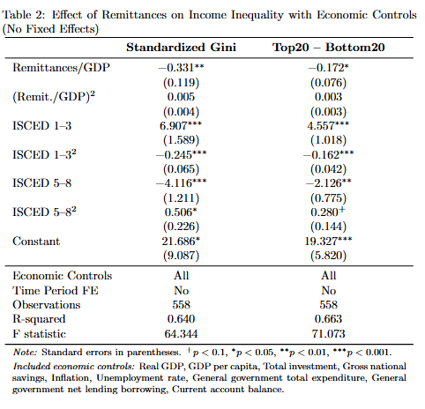
Economic controls
Table 2 adds economic controls and shows that the relationship between remittances and inequality becomes linear and negative.
The role of education becomes more prominent: basic education exhibits an inverted-U pattern, and the overall explanatory power improves substantially (R² increases from ~0.22 to ~0.64).

Slide 6
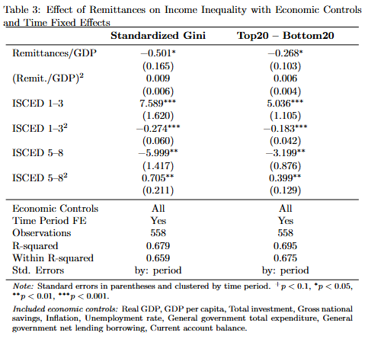
Time fixed effects
Table 3 incorporates time fixed effects and confirms the robustness of previous results: the relationship between remittances and inequality remains negative and linear, and ISCED 1–3 continues to exhibit an inverted-U shape.
While the U-shaped trend for ISCED 5–8 was already suggestive in earlier models, its effect becomes statistically significant with the inclusion of time fixed effects.

Slide 7
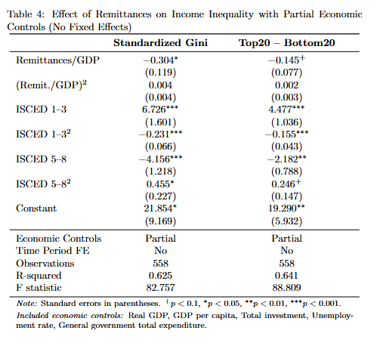
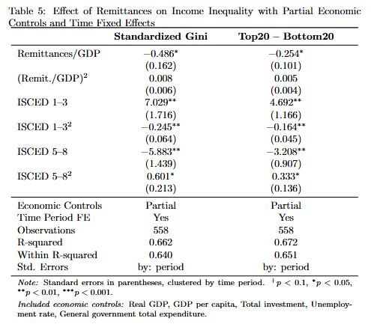
Reduced controls (robustness check)

Slide 8
Summary
Reliance on remittances reduce inequality: The relationship is consistently negative and becomes clearly linear after controlling for economic conditions—contradicting prior inverted-U hypotheses.
Basic education has an inverted-U effect: ISCED 1–3 initially increases inequality but reduces it as access expands; this pattern becomes significant after including economic controls.
Higher education shows a U-shaped effect: ISCED 5–8 consistently lowers inequality, but its nonlinear (U-shaped) effect becomes statistically significant only after adding time fixed effects.
Results pass the robustness check

